Slide 1
Merge Sort Invented by John von Neumann in 1945
Merge sort is the classic divide and conquer algorithm, and is used as a canonical example for explaining this algorithm concept
Kurt Friedrich
Spring 2015
Much taken from:
http://en.wikipedia.org/wiki/Merge_sort

Slide 2
Merge Sort
Conceptually, a merge sort works as follows:
Keep dividing the unsorted list into n sublists, until each sublist contains just 1 element; a list of 1 element is sorted.
Walk back up the recursion trees, and at each return, merge 2 sublists to produce a new sorted sublist. This “merge” step is where the work is done, but its beauty is that a merge of 2 sorted lists is a very simple operation (compared to merging non-sorted lists).
As you look at the next item to merge from the 2 segments, you only have to look at the top one from each segment to see which is smaller, since you know each is the smallest
The last recursion return will merge into 1 sublist which will be the complete sorted list.

Slide 3
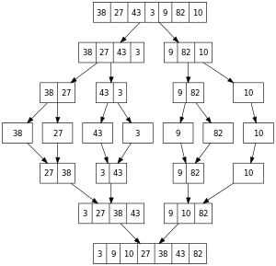
A recursive merge sort algorithm used to sort an array of 7 integer values. These are the steps a human would take to emulate merge sort (top-down)
Key point: As you get to the “27” and decide should
it go next, you only have to look at the first item in
the second list, as you know, since it is a sorted list,
that it’s the smallest item in that list.

Slide 4
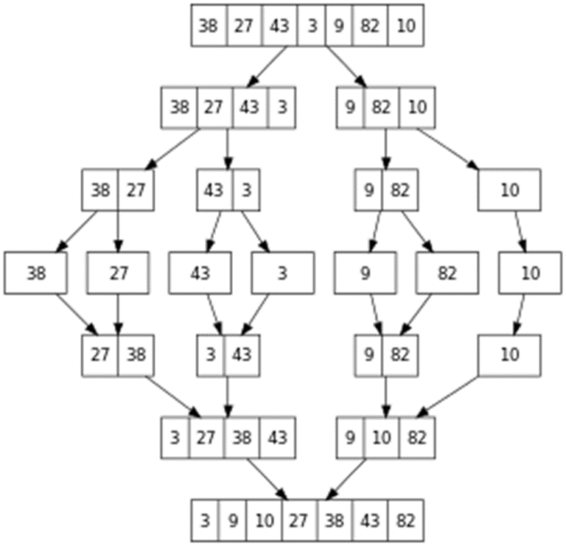

Slide 5
Merge Sort
Watch animations to see what we are going to do in code
Simple one in Wikipedia, gives idea, doesn’t quite match the code:
http://en.wikipedia.org/wiki/Merge_sort
More elaborate, and more akin to how the code runs
http://www.cs.usfca.edu/~galles/visualization/ComparisonSort.html

Slide 6
Watching MergeSort walk thru its sort with our sample.
Look at the program, first array
{ 4, 1, 3, 2 };
Follow the recursion.
Divide and conquer

Slide 7
Into MSR with full 4 element array 4, 1, 3, 2
Into MSR with top half of the array
Into MSR with top fourth of the array (left side)
Into MSR with 2nd fourth of the array (right side)
Into merge, leave with 1, 4, 3, 2
Return into MSR with bottom half of the array
Into MSR with 3rd fourth of the array (left side)
Into MSR with 4th fourth of the array (right side)
Into merge, leave with 1, 4, 2, 3
Return into MSR with both halves of the array
Into merge, leave with 1, 2, 3, 4

Slide 8
Performance
In sorting n objects, merge sort has an average and worst-case performance of O(n log n). It is mathematically proven that for a comparison based sort, you can not do better than this..
In the worst case, merge sort does about 39% fewer comparisons than quicksort does in the average case.
In terms of moves, merge sort's worst case complexity is O(n log n)—the same complexity as quicksort's best case, and merge sort's best case takes about half as many iterations as the worst case
But Merge sort's most common implementations does not sort in place;
therefore, it needs 2 times the memory size of the input (there are versions that need only n/2 extra space).
Although heapsort has the same time bounds as merge sort, it requires only O(1) auxiliary space instead of merge sort's O 2n).
On typical modern architectures, efficient quicksort implementations generally outperform mergesort for sorting in-memory arrays.
On the other hand, merge sort is a stable sort and is more efficient at handling slow-to-access sequential media.
Merge sort is often the best choice for sorting a linked list: in this situation it is relatively easy to implement a merge sort in such a way that it requires only O(1) extra space, and the slow random-access performance of a linked list makes some other algorithms (such as quicksort) perform poorly, and others (such as heapsort) completely impossible.

Slide 9
Inversion Count for an array
Inversion Count for an array indicates – how far an array is from being sorted.
If it is already sorted then inversion count is 0.
If it is sorted in complete reverse order, then the count is the maximum.
Example: The sequence 2, 4, 1, 3, 5 has three inversions
(2, 1), (4, 1), (4, 3).
Can get the inversion count for free during the merge stage of the Merge Sort.
Can use the inversion count as a metric for a movie recommender.
If users rank a set of movies from one to five, then that ranking can be compared to other people’s rankings. It is reasonable to suggest that people with “similar rankings” might have similar taste and therefore recommend movies that one person likes to the other.

